Slide 1

Decentralized Movie Recommendation Systems
Authors:
Niloy Sarkar 21201638
Sakib Rokoni 23273004
Utsho Dey 24366019
GROUP 6

Slide 2
Introduction
1
Recommendation systems
Prevalence in digital platforms (e-commerce, streaming services)
Importance in enhancing user experience
Challenges with centralized systems:
Privacy concerns
Data security risks
Monopolistic control by large corporations
Lack of user control over personal data

Slide 3
Research Objectives
2
Primary aim: Develop and evaluate a decentralized movie recommendation system
Research Goal :
1. Implementing decentralized architecture for personalized recommendations
2. Maintaining/improving recommendation quality compared to centralized systems
3. Ensuring fairness and diversity in content recommendations
4. Incentivizing user engagement without compromising privacy

Slide 4
Background
3
1. Traditional centralized recommendation systems: Collaborative filtering Content-based filtering Hybrid methods | 2. Privacy and security concerns: Data breaches Unauthorized data usage User profiling | 3. Emerging decentralized technologies: Blockchain Federated learning Peer-to-peer networks

Slide 5
Methodology - Theoretical Framework
4
Principles of distributed computing
Content-based recommendation algorithms
Rationale for chosen method:
Decentralization benefits
Content-based approach advantages
System adaptability

Slide 6
Methodology - System Architecture
5
Three main components:
Scraping Server
Recommendation Server
Rebuild Server
Docker containerization
NGINX load balancing
Relevance to distributed computing concepts

Slide 7
Data Collection and Processing
6
Web scraping process using BeautifulSoup Library in Python
Dataset details: 25,000 movies from IMDb. Link
Data collected: title, year, genres, director, cast, keywords, ratings, overview
Data preprocessing steps:
Text cleaning
Categorical data conversion
Numerical data handling
Feature engineering

Slide 8
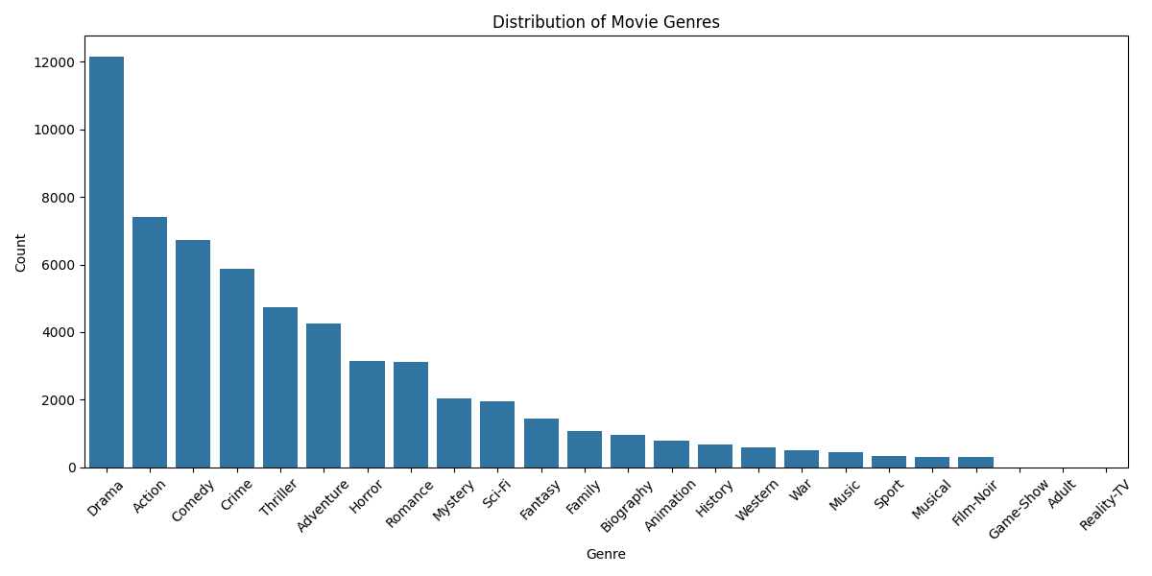
Data Analysis - Movie Distribution by Genre
7

Slide 9
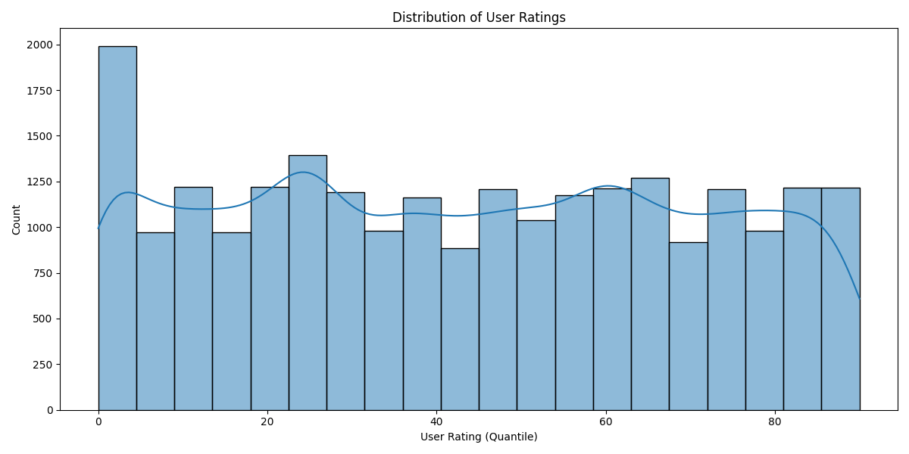
Data Analysis - Movie Distribution by User
8

Slide 10
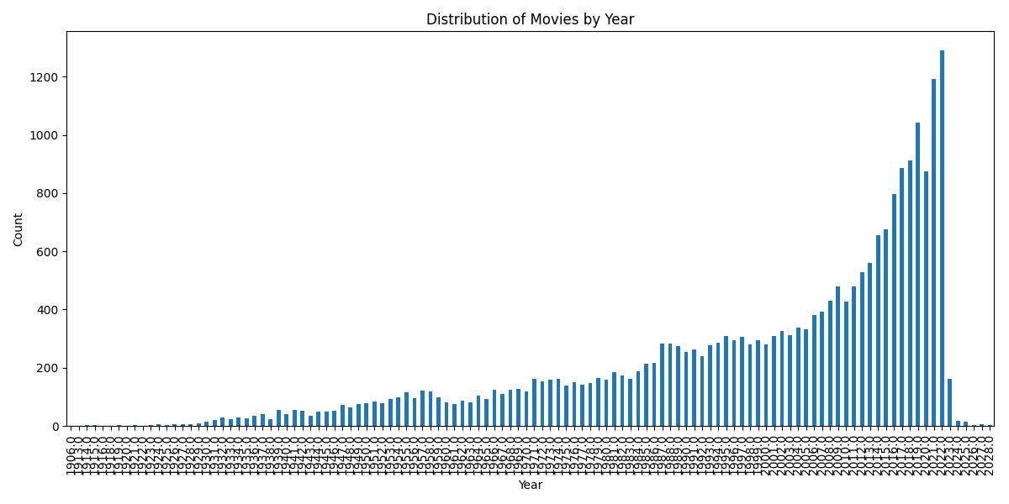
Data Analysis - Movie Distribution by Year
9

Slide 11
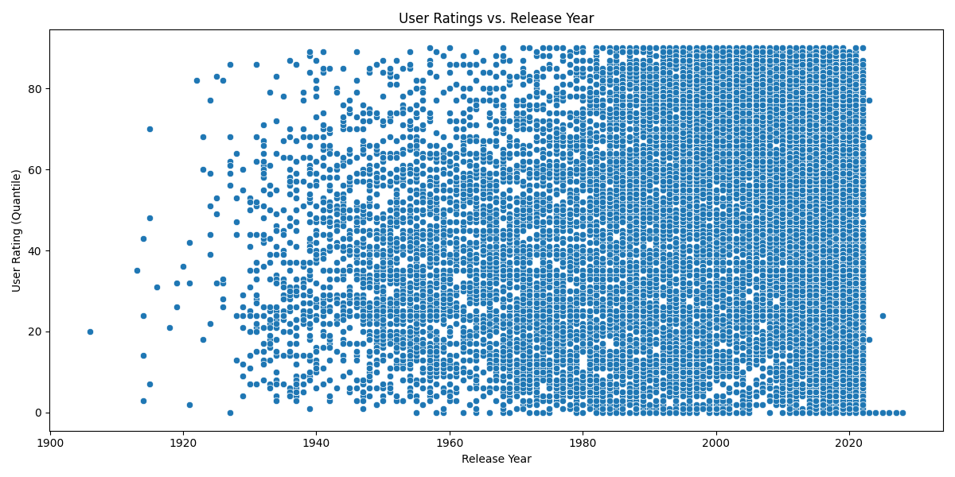
Data Analysis - User Rating vs Year
10

Slide 12
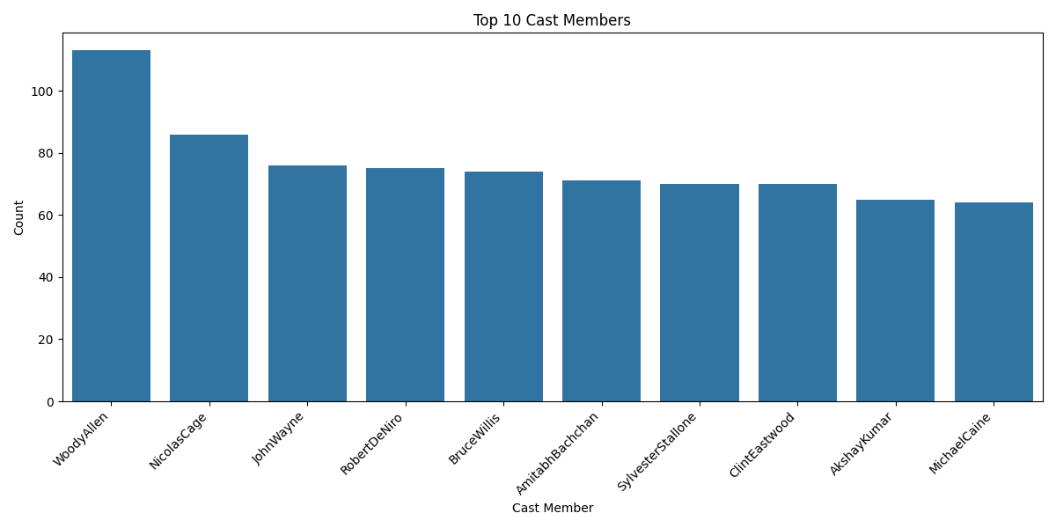
Data Analysis - Top Cast Members
11

Slide 13
Recommendation Algorithms
12
Content-based approach explanation
Text vectorization using sklearn CountVectorizer
Cosine similarity calculation
Top 5 recommendation generation process
Advantages of this approach in a decentralized context

Slide 14
Decentralization Implementation
13
Local data storage on each node
Independent recommendation generation
Periodic updates mechanism
Node discovery using UDP broadcasts
Challenges addressed in decentralization

Slide 15
Ethical Considerations and FAIR Principles
14
Privacy preservation methods
Transparency in recommendation process
Fairness in content suggestions
FAIR data principles implementation:
Findable
Accessible
Interoperable
Reusable

Slide 16
Results - System Performance
15
Scalability results:
Graph showing response time vs. number of nodes
Discussion of near-linear scalability
Fault tolerance findings:
System behavior with 20% node failure
Recovery process

Slide 17
Results - Recommendation Quality
16
Accuracy metrics:
Precision: 0.82
Recall: 0.75
NDCG: 0.79
User study results:
85% rated recommendations as "good" or "excellent"
90% found recommendations diverse

Slide 18
Additional Insights
17
Average user rating and standard deviation
Oldest and newest movies in the dataset
Top-rated movies examples
Most common plot keywords
Genre-specific rating trends

Slide 19
Conclusions
18
Key Findings:
1. Privacy preservation effectiveness
2. Scalability achievements
3. Fault tolerance demonstration
4. Offline functionality benefits
5. High-quality recommendations
Alignment with ethical data practices
Implications for privacy-preserving recommendation systems

Slide 20
Future Work
19
Hybrid recommendation approaches
Enhanced data collection methods
Personalization improvements
Cross-platform deployment
Blockchain integration possibilities
Advanced NLP techniques
Performance optimization strategies
Dynamic node management
Security enhancements
Explainable AI integration

Slide 21
References
20
Li, Wenjuan, et al. "Blockchain-based trust management in cloud computing systems: a taxonomy, review and future directions." Journal of Cloud Computing 10.1 (2021): 35.
Zamora, Juan, Héctor Allende-Cid, and Marcelo Mendoza. "Distributed clustering of text collections." IEEE Access 7 (2019): 155671-155685.
Chen, Chaochao, et al. "Privacy preserving point-of-interest recommendation using decentralized matrix factorization." Proceedings of the AAAI conference on artificial intelligence. Vol. 32. No. 1. 2018.
Fadi, Oumaima, Zkik Karim, and Boulmalf Mohammed. "A survey on blockchain and artificial intelligence technologies for enhancing security and privacy in smart environments." IEEE Access 10 (2022): 93168-93186.
Bobadilla, Dariel, and Carlo Lipizzi. "A blockchain-based collaborative filtering recommendation system based on trust." 2021 18th International Computer Conference on Wavelet Active Media Technology and Information Processing (ICCWAMTIP). IEEE, 2021.
Lavanya, R., and B. Bharathi. "Movie recommendation system to solve data sparsity using collaborative filtering approach." Transactions on Asian and Low-Resource Language Information Processing 20.5 (2021): 1-14.
Yeh, Tzu-Yu, and Rasha Kashef. "Trust-Based collaborative filtering recommendation systems on the blockchain." Advances in Internet of Things 10.4.(2020): 37-56.

Slide 22
References
21
Sharma, Nisha, and Mala Dutta. "Movie recommendation systems: A brief overview." Proceedings of the 8th international conference on computer and communications management. 2020.
Abduljabbar, Tamara Abdulmunim, et al. "A Secured Movie Recommendation System using Decentralized Blockchain Network." 2022 9th International Conference on Behavioural and Social Computing (BESC). IEEE, 2022.
Kim, Jinsu, et al. "Efficient privacy-preserving matrix factorization for recommendation via fully homomorphic encryption." ACM Transactions on Privacy and Security (TOPS) 21.4 (2018): 1-30.
Guo, Jianlan, et al. "Decentralized federated learning with privacy-preserving for recommendation systems." Enterprise Information Systems 17.9 (2023): 2193163.
Abduljabbar, Tamara Abdulmunim, et al. "A Secured Movie Recommendation System using Decentralized Blockchain Network." 2022 9th International Conference on Behavioural and Social Computing (BESC). IEEE, 2022.
Chen, Chaochao, et al. "Privacy preserving point-of-interest recommendation using decentralized matrix factorization." Proceedings of the AAAI conference on artificial intelligence. Vol. 32. No. 1. 2018.
Kouicem, Djamel Eddine, et al. "Decentralized blockchain-based trust management protocol for the Internet of Things." IEEE Transactions on Dependable and Secure Computing 19.2 (2020): 1292-1306.
Himeur, Yassine, et al. "Blockchain-based recommender systems: Applications, challenges and future opportunities." Computer Science Review 43 (2022): 100439.

Slide 23
Q&A
22
Thank YOU…

